Slide 1


STRAVA FITNESS DATA ANALYTICS CASE STUDY
Bellabeat Smart Device Usage Analysis
Prepared By: AYUSH DASH
Date: 12 - 06 - 2026
内容由AI生成

Slide 2

Content
01
02
03
04
Project Overview & Scope
Data Architecture & Processing
Power BI: Model, Measures & Dashboards
Key Business Insights & Recommendations
内容由AI生成

Slide 3
part-01
Project Overview & Scope
内容由AI生成

Slide 4


Data-Driven Strategy for Bellabeat
Project Objective
Understand how users interact with smart fitness devices and identify opportunities to improve user engagement, product adoption, customer retention, wellness experience, and marketing strategy.
End-to-End Analytics Workflow
Data collection from Fitbit trackers → SQL data cleaning and validation → Python exploratory analysis → Power BI dashboard visualization → Business insights → Strategic recommendations.
内容由AI生成

Slide 5
Dataset Characteristics
Data Sources
18 CSV files covering daily, hourly, minute-level activity, sleep, heart rate, and weight & BMI data for 33 users. Daily datasets include steps, calories, intensities; hourly datasets track granular trends; minute-level data support deep behavioral analysis.
Data Granularity
Multiple time resolutions (daily, hourly, minute-level) enable cross-dimensional analysis of user behavior patterns, from macro engagement trends to micro activity spikes.
内容由AI生成

Slide 6
part-02
Data Architecture & Processing
内容由AI生成

Slide 7
SQL Database Setup & Cleaning
01
02
Database Structure
SQL Tasks Performed
Imported 10 core tables into `bellabeat_analysis` database in MySQL, including dailyActivity, sleepDay, hourlyCalories, heartrate_seconds, etc.
Record count validation, duplicate detection, missing value analysis, data cleaning, data validation, and aggregation queries to ensure data integrity.
内容由AI生成

Slide 8


SQL Business Analysis Insights
01
Key Analytical Dimensions
02
Core Finding
Daily activity analysis, calorie expenditure analysis, sleep analysis, user ranking, activity segmentation, and hourly trend analysis.
Physical activity levels are strongly correlated with calorie expenditure and overall user engagement, confirming activity as a primary engagement driver.
内容由AI生成

Slide 9

Python (Pandas) Workflow & Visualizations
Analytical Pipeline
Discovery Highlights
Import data → Clean with Pandas → Exploratory data analysis → Visualize with Matplotlib/Seaborn → Derive insights. Charts: daily steps distribution, calories distribution, sleep duration, activity segments, scatter plots (steps vs calories, sleep vs steps), correlation heatmap, user segmentation.
Most users are moderately active; activity levels vary significantly across the sample; sleep duration differs notably; higher activity leads to greater calorie burn.
内容由AI生成

Slide 10
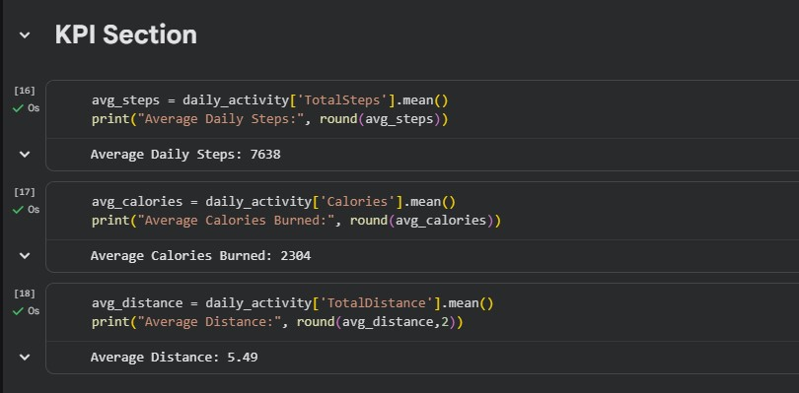
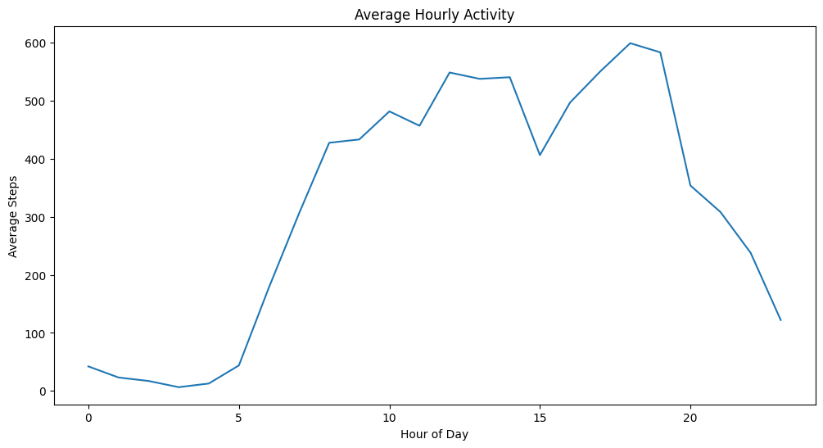
Python (Pandas) Workflow & Visualizations Screenshots
KPI Section
Average Hourly Activity
内容由AI生成

Slide 11
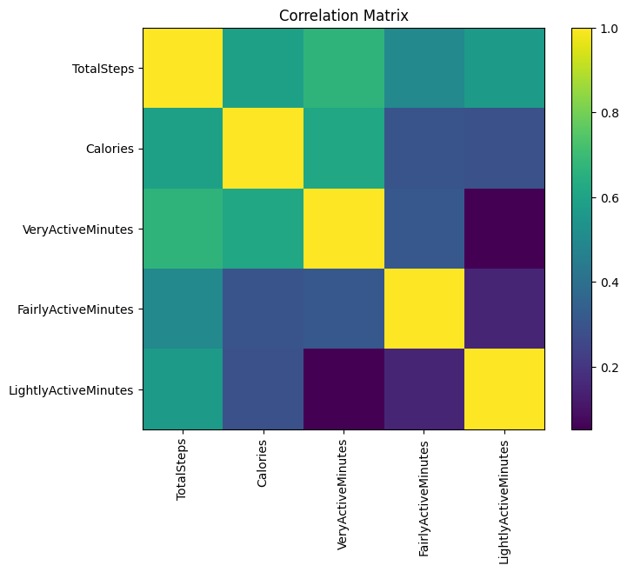
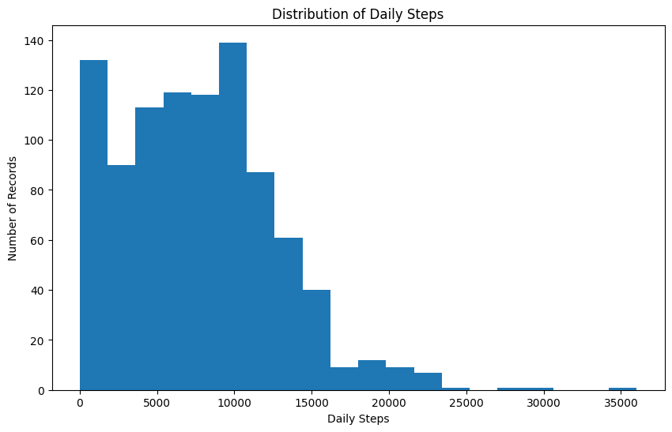
Python (Pandas) Workflow & Visualizations Screenshots
Correlation Matrix
Distribution of Daily Steps
内容由AI生成

Slide 12
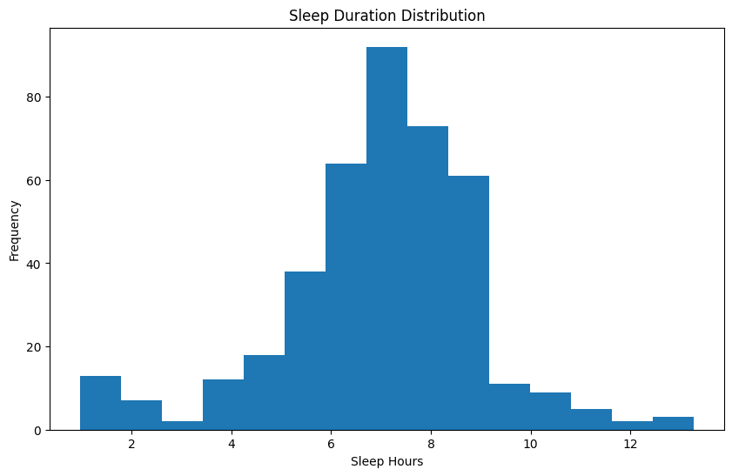
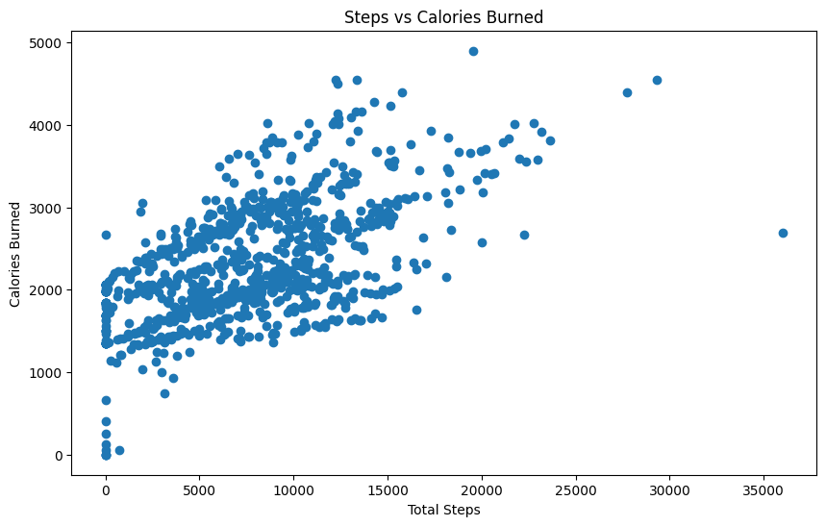
Python (Pandas) Workflow & Visualizations Screenshots
Sleep Duration Distribution
Steps vs Calories Burned
内容由AI生成

Slide 13
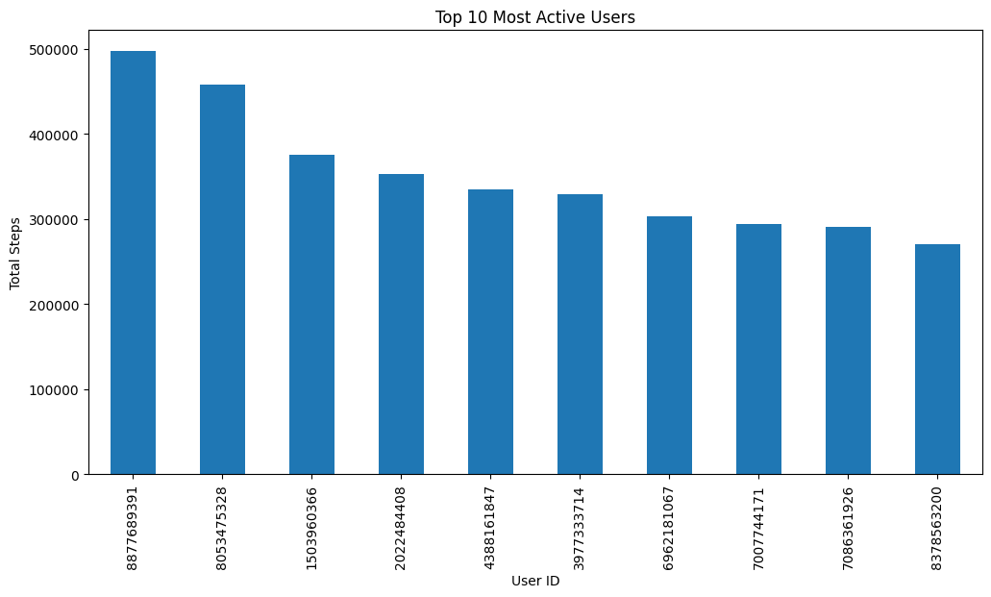
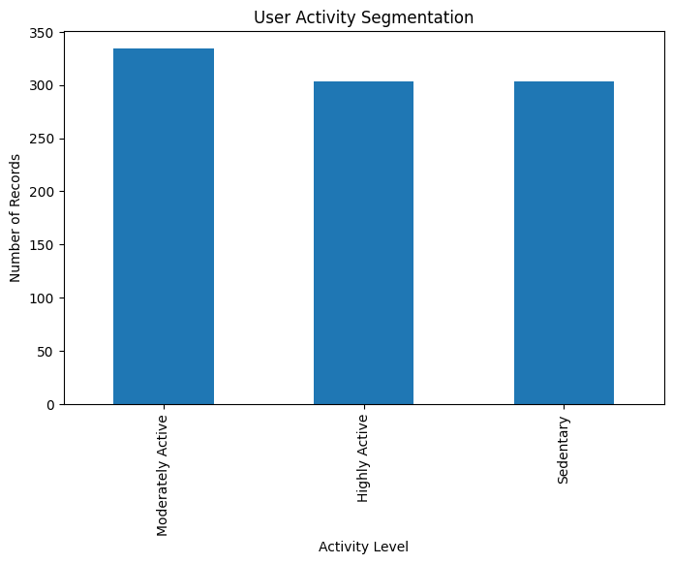
Python (Pandas) Workflow & Visualizations Screenshots
Top 10 Most Active Users
User Activity Segmentation
内容由AI生成

Slide 14
part-03
Power BI: Model, Measures & Dashboards
内容由AI生成

Slide 15

Star Schema Data Model
Design Structure
Dimension table: Dim_User. Fact tables: dailyActivity, sleepDay, hourlySteps, hourlyCalories, hourlyIntensities, heartrate_seconds, WeightLogInfo. Benefits include faster queries and professional BI architecture.
Performance Advantages
Star schema simplifies relationships, improves query performance, and enables scalable cross-table analysis for complex fitness metrics.
内容由AI生成

Slide 16
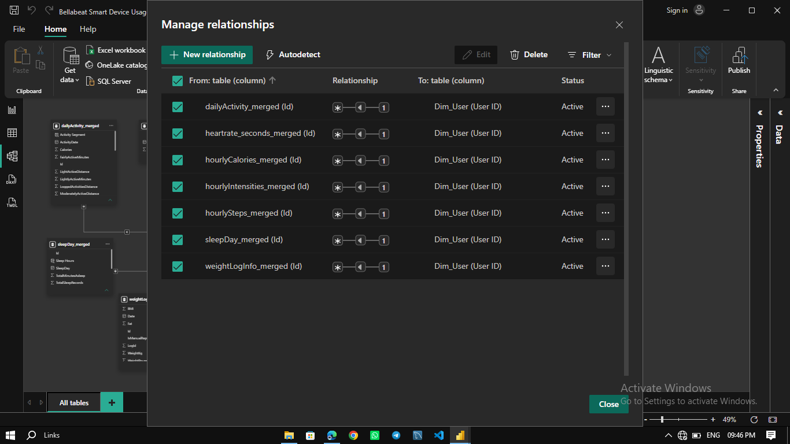
Relationship Screenshots
内容由AI生成

Slide 17
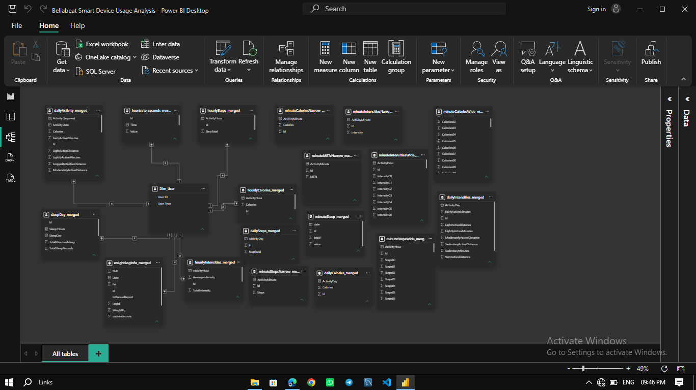
Model View Screenshots
内容由AI生成

Slide 18

DAX Measures
Core Calculated Metrics
Daily activity measures (total users, average steps, max steps, total distance, total calories, active minutes breakdown), sleep measures (average/max/min sleep hours), heart rate & weight measures, hourly measures, and composite KPIs (Fitness Score, Wellness Score, Engagement Score).
Segmentation Measures
Derived user segments: Sedentary Users (<5000 steps), Moderately Active Users (5000–9999 steps), Highly Active Users (10000+ steps).
内容由AI生成

Slide 19


Dashboard Pages
Page Structure
Seven dashboards: Home, Executive Overview, Physical Activity Analysis, Calorie Expenditure Analysis, Sleep & Wellness Analysis, Hourly Activity Analysis, User Segmentation & Business Insights.
Executive Dashboard KPIs
Total users, total steps, total calories, total distance, average sleep hours, average heart rate – providing a complete snapshot of user fitness behavior.
内容由AI生成

Slide 20
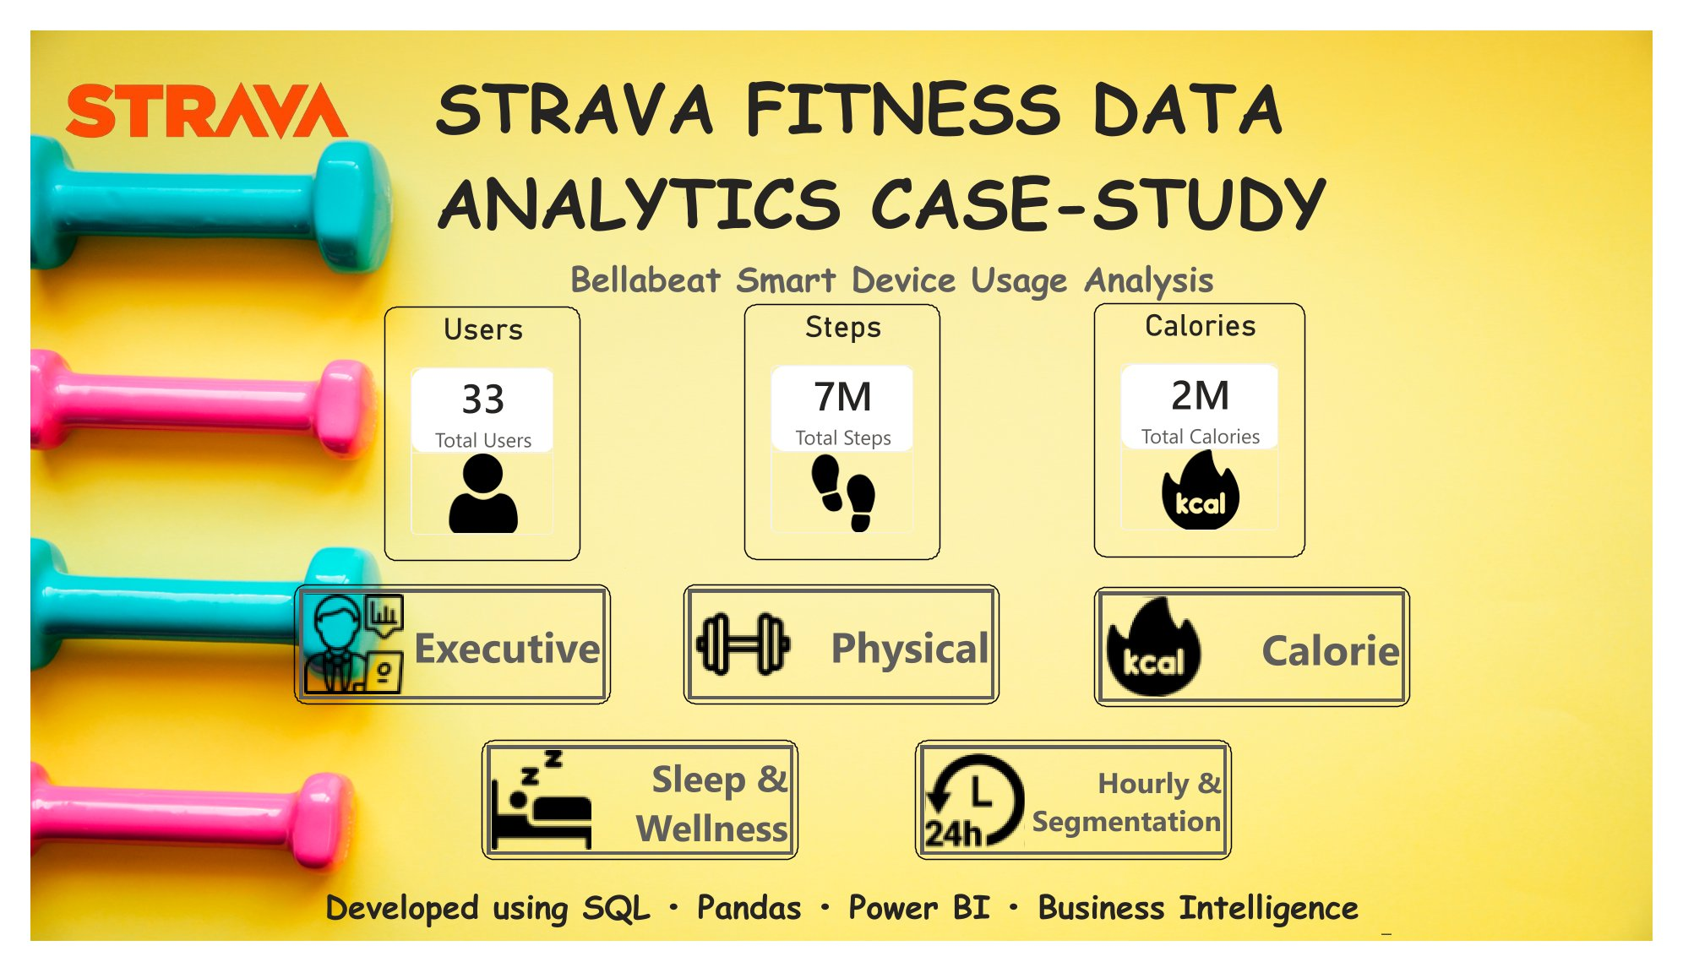
Home Dashboard Screenshot
内容由AI生成

Slide 21
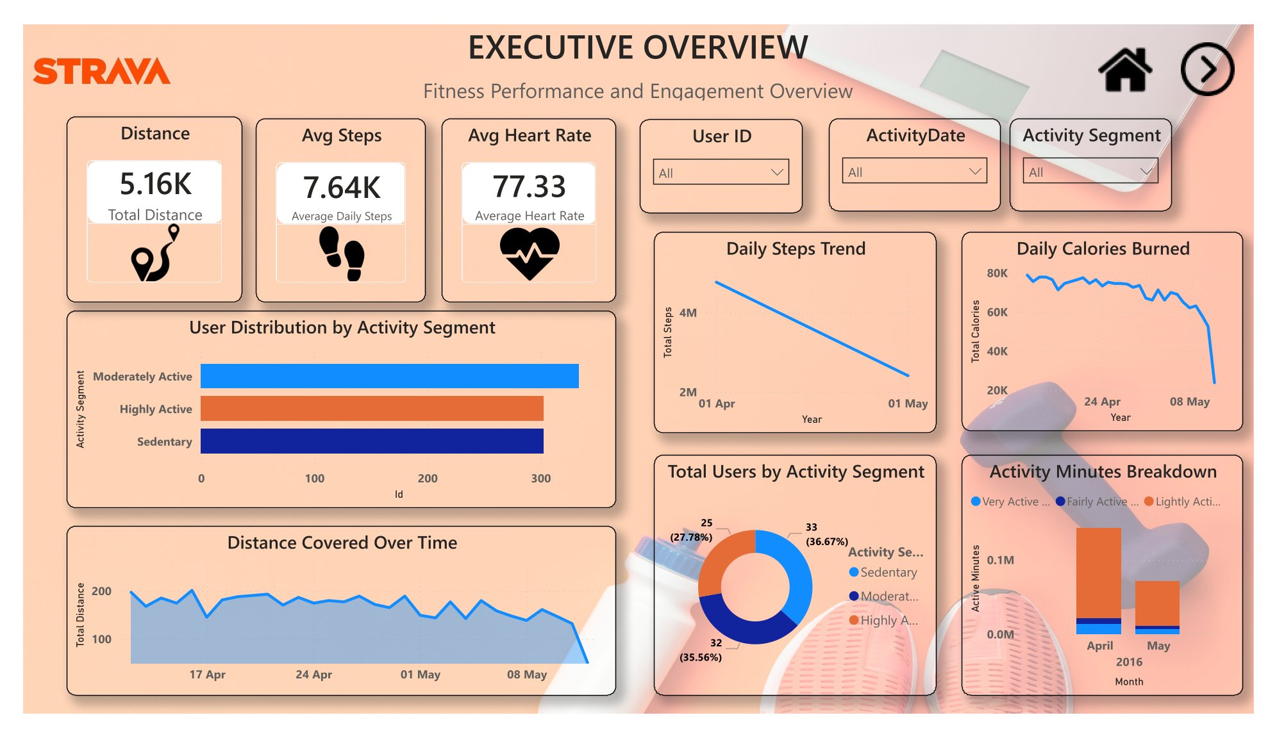
Executive Overview Dashboard Screenshot
内容由AI生成

Slide 22
Physical Activity & Calories Dashboard
01
02
Key Metrics Displayed
Business Insight
Average daily steps, active minutes breakdown (very, fairly, lightly), distance covered, calories burned.
Many users fail to reach 10,000 steps; activity directly impacts calorie expenditure; active users are the primary contributors to overall platform performance.
内容由AI生成

Slide 23
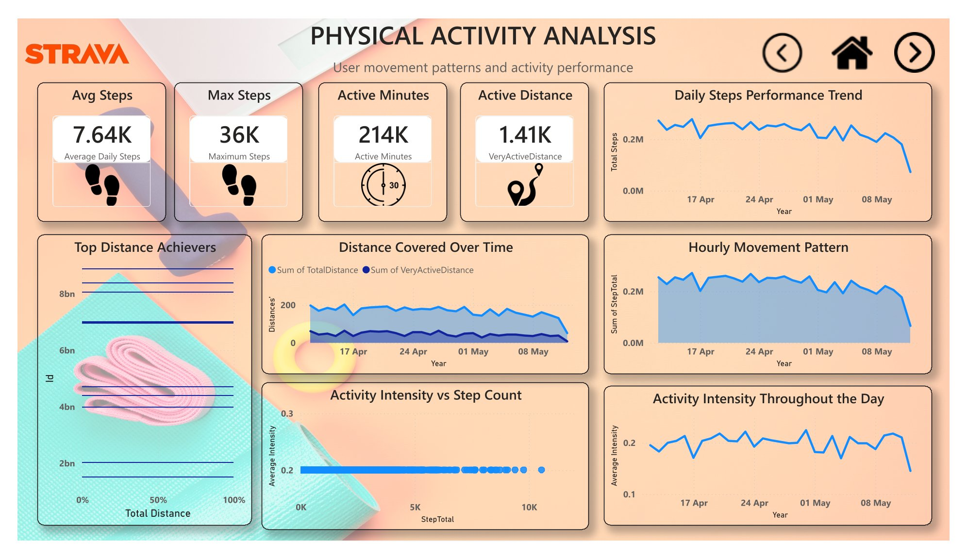
Physical Activity Analysis Dashboard Screenshot
内容由AI生成

Slide 24
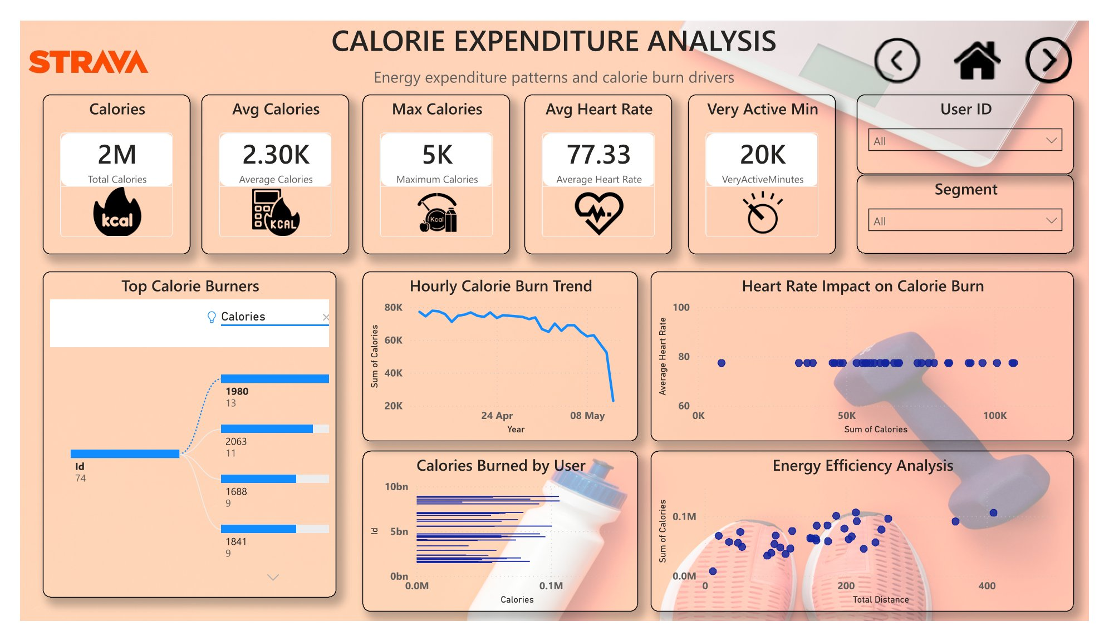
Calorie Activity Analysis Dashboard Screenshot
内容由AI生成

Slide 25

Sleep & Wellness Dashboard
Key Metrics & Insights
Average sleep hours, sleep duration distribution, heart rate trends, BMI. Sleep behavior varies significantly; better sleep supports higher wellness outcomes; wellness indicators reveal user health trends.
Actionable Observation
Users with consistent sleep patterns exhibit higher engagement scores, suggesting sleep quality as a key lever for retention.
内容由AI生成

Slide 26
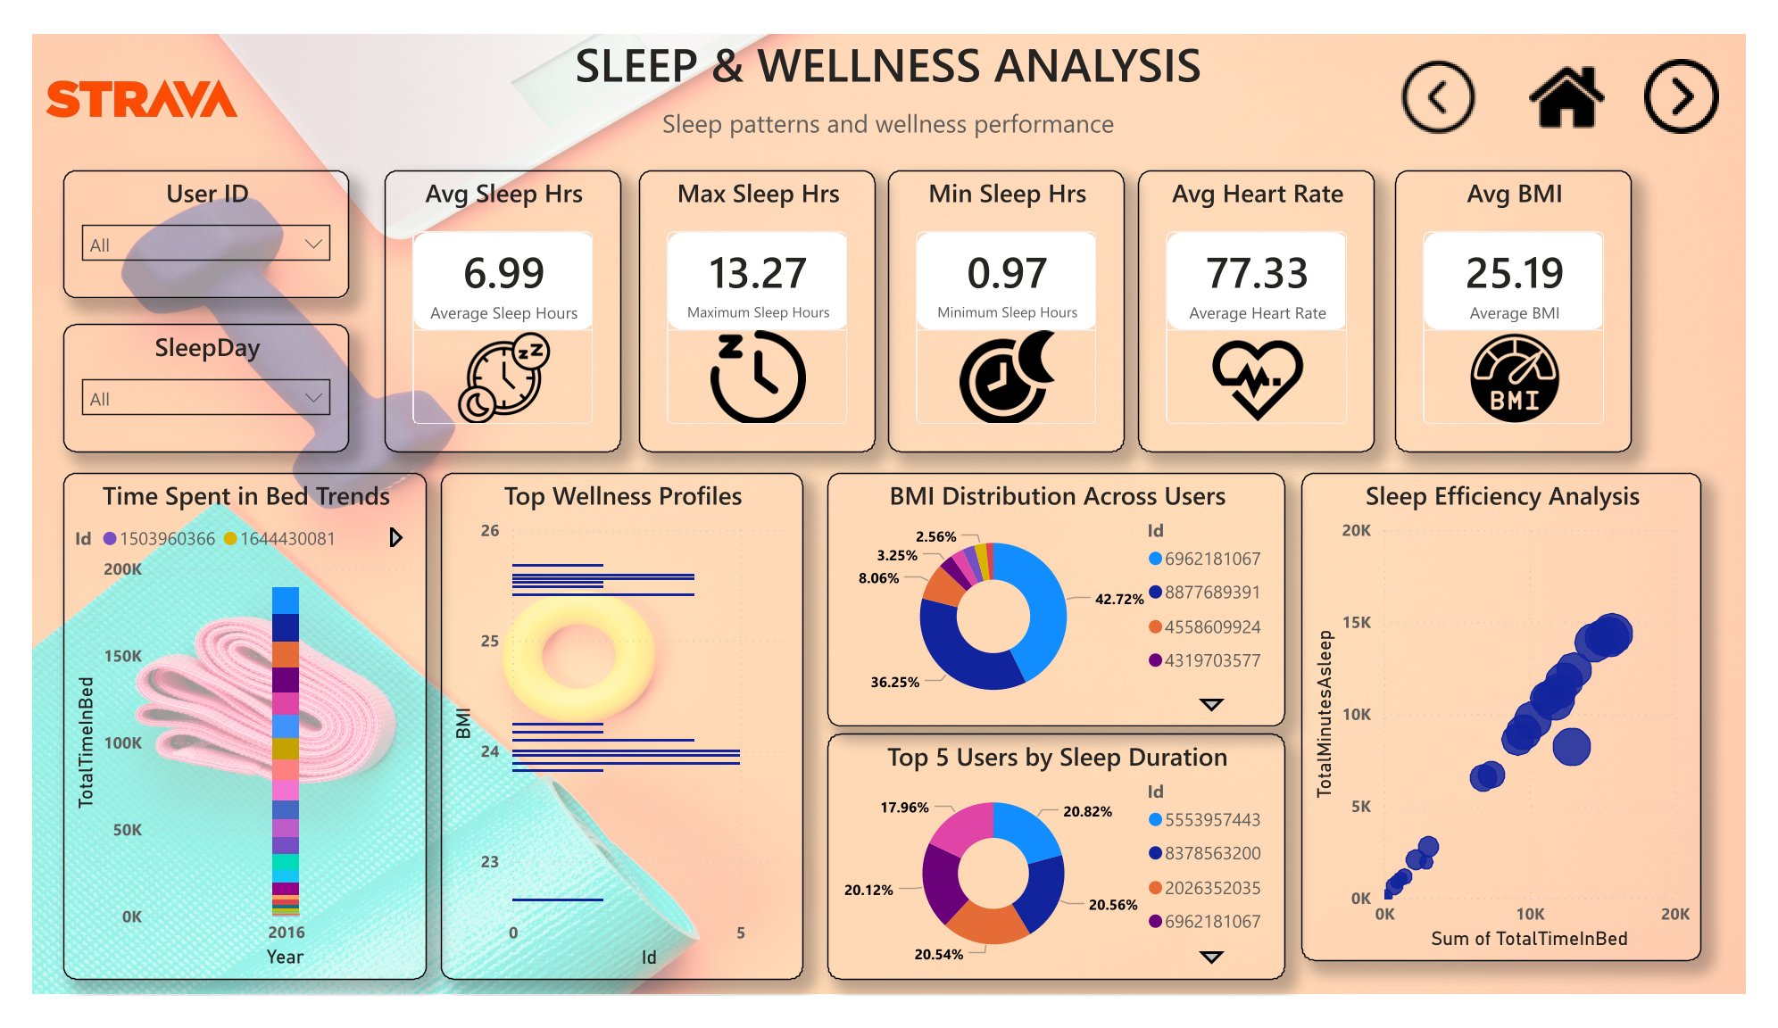
Sleep & Wellness Analysis Dashboard Screenshot
内容由AI生成

Slide 27

Hourly Activity & Segmentation Dashboard
Analysis Areas
Peak activity hours, hourly steps/calories, intensity trends, and user segmentation into three behavioral groups.
Segment Profiles
Sedentary users (<5000 steps) represent the biggest opportunity for improvement; moderately active users (5000–9999) form the largest segment; highly active users (10000+) demonstrate strongest retention potential.
内容由AI生成

Slide 28
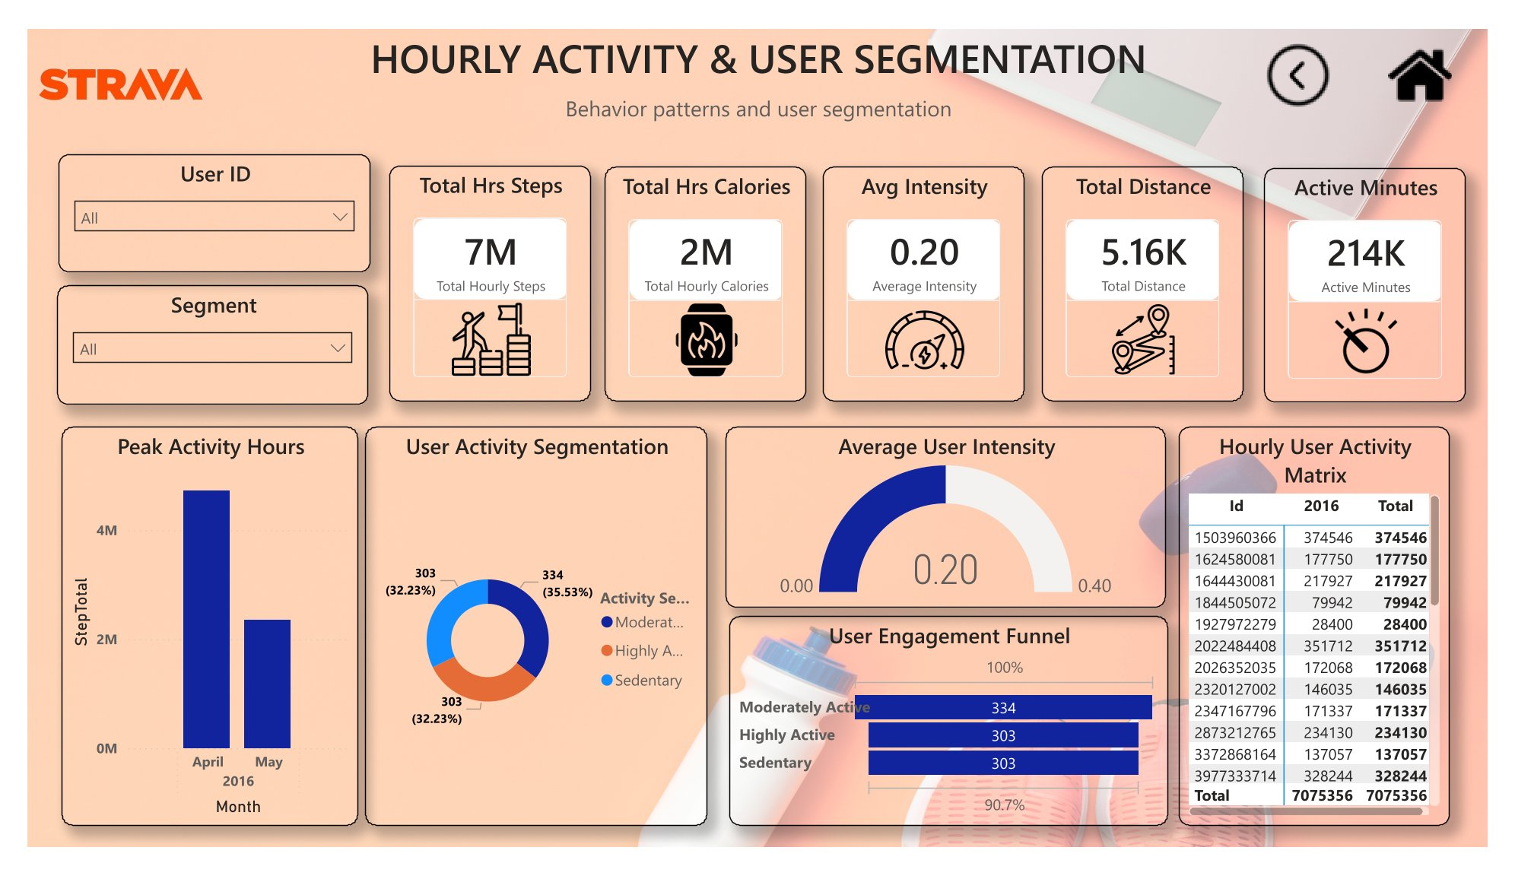
Hourly & Segmentation Analysis Dashboard Screenshot
内容由AI生成

Slide 29
part-04
Key Business Insights & Recommendations
内容由AI生成

Slide 30
Critical Data-Driven Findings
Segment Opportunity
Engagement Variability
Most users are moderately active; sleep patterns influence overall wellness; activity peaks occur during specific hours; sedentary users represent the largest untapped growth segment.
User engagement varies considerably across the user base, indicating room for personalized interventions.
内容由AI生成

Slide 31


Strategic Recommendations
User Engagement Tactics
Wellness Programs
Marketing & Retention
Implement achievement badges, activity challenges, and goal-tracking features to boost daily activity and reduce churn among sedentary users.
Introduce sleep coaching, recovery monitoring, and personalized wellness scores to enhance health outcomes and differentiate product value.
Deploy personalized notifications, segment-based campaigns, and retention programs that leverage behavioral data to increase long-term adoption.
内容由AI生成

Slide 32
Thank you
内容由AI生成

